Slide 1
Gyroscope: Mumbai and Bangalore looks ok
The root mean square of z-axis is small than 0.0060 rad/s (Gyroscope z-axis control car heading)
The static detect rate about sensor over 95% (sensor + car speed to detect static)
Accelerometer: Mumbai and Bangalore looks ok
The root mean square of x/y-axis is small than 0.0890 m/s^2 (Accelerometer x/y-axis control roll/pitch)
The difference of leveling is small than 6 degree (roll: 4.89 degree, pitch: 2.34 degree)
 | Mumbai (5mins) | Mumbai (30mins) | Bangalore (5mins) | Bangalore (30mins)
Gyro_RMS_X (rad/s) | 0.00645 | 0.00503 | 0.00140 | 0.00190
Gyro_RMS_Y (rad/s) | 0.00102 | 0.00098 | 0.00150 | 0.00141
Gyro_RMS_Z (rad/s) | 0.00063 | 0.00061 | 0.00052 | 0.00050
Static detect rate (%) | 99.29% | 99.78% | 97.36% | 98.85%
 | Mumbai (5mins) | Mumbai (30mins) | Bangalore (5mins) | Bangalore (30mins)
Acc_RMS_X (m/s^2) | 0.04176 | 0.03616 | 0.02528 | 0.02096
Acc_RMS_Y (m/s^2) | 0.07552 | 0.06176 | 0.06352 | 0.05088
Acc_RMS_Z (m/s^2) | 0.09776 | 0.07616 | 0.07536 | 0.05776
Leveling, roll/pitch (deg/deg) | 176.74 / 13.22 | 176.74 / 13.22 | -179.00 / 10.88 | -179.00 / 10.88

Slide 2
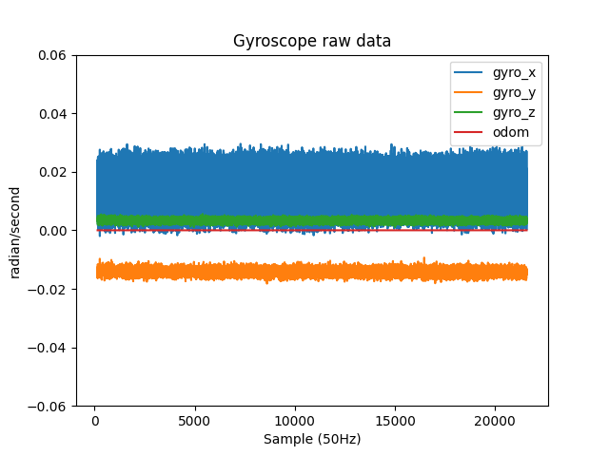
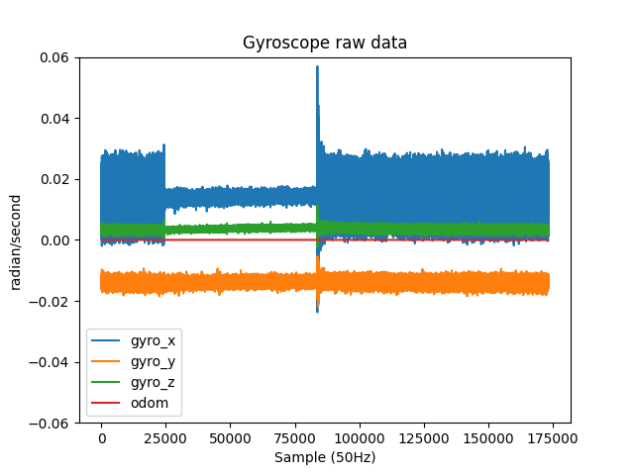
(Gyroscope) Mumbai -> OK
5 mins
30 mins
5 minutes
Possibility: Air conditioning system
or engine speed change

Slide 3
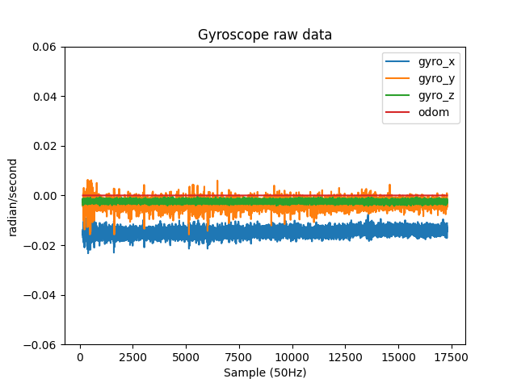
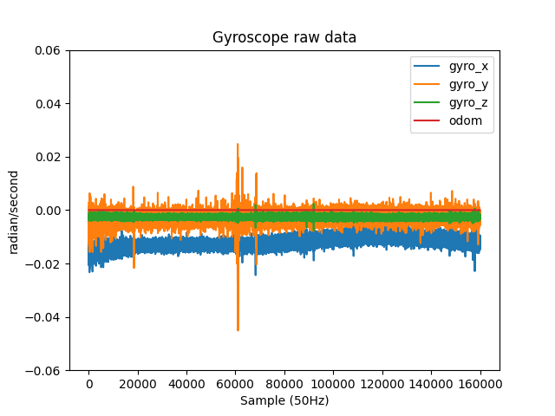
(Gyroscope) Bangalore -> OK
5 mins
30 mins

Slide 4
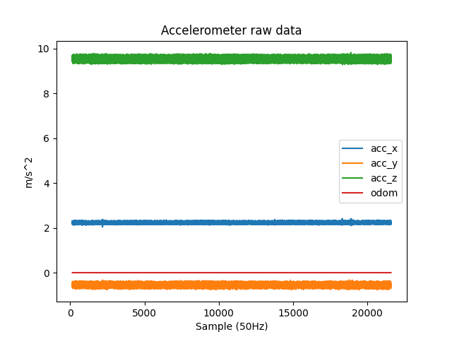
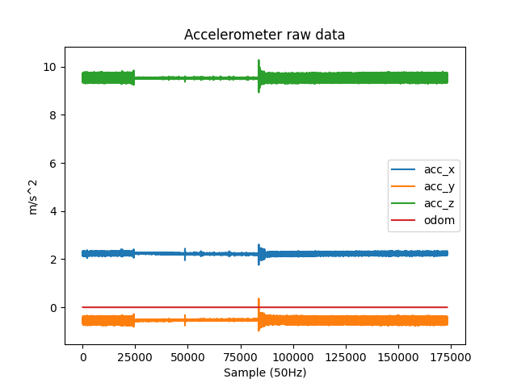
(Accelerometer) Mumbai -> OK

Slide 5
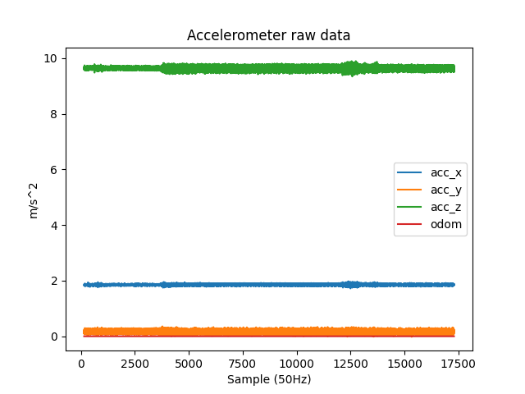
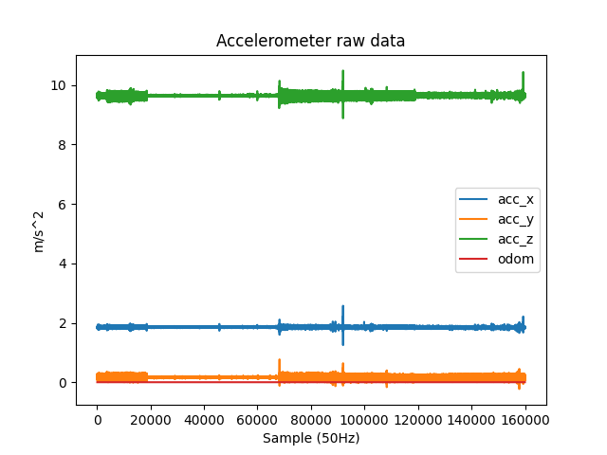
(Accelerometer) Bangalore -> OK

Slide 6
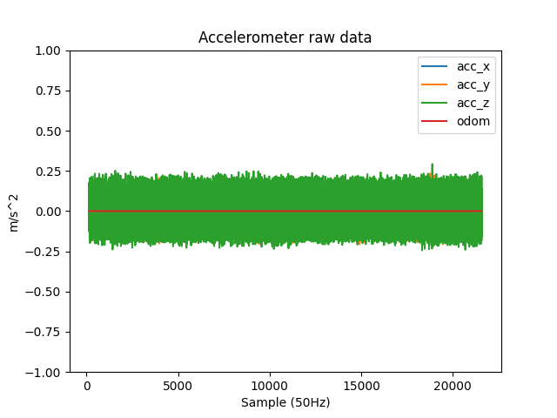
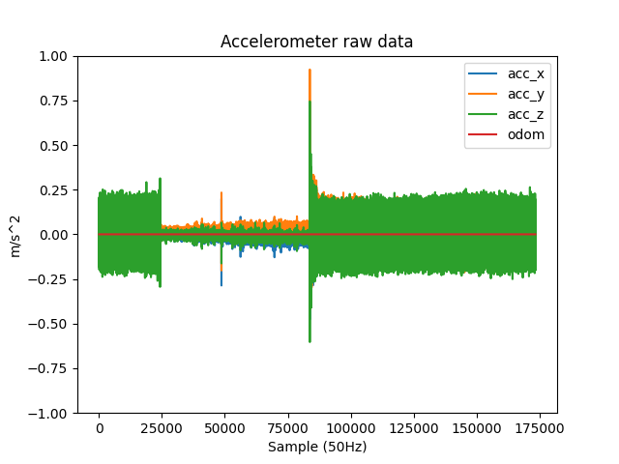
(Accelerometer, remove Gravity) Mumbai -> OK
5 mins
30 mins
Possibility: Air conditioning system
or engine speed change

Slide 7
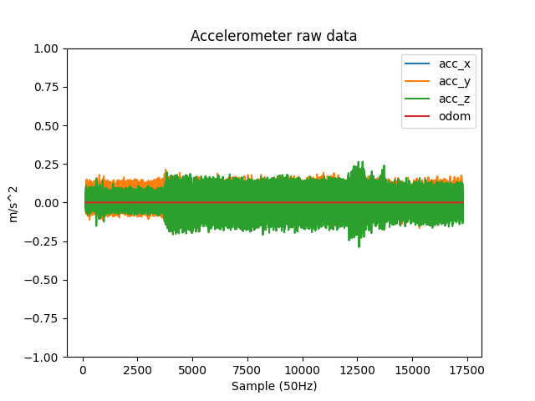
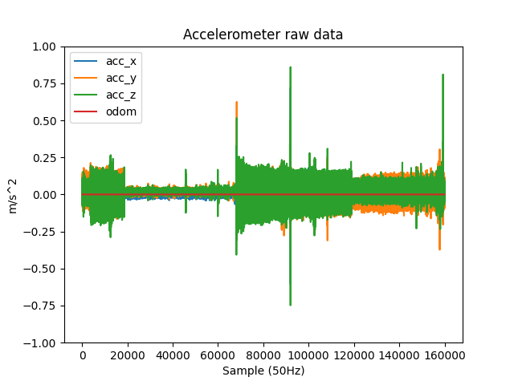
(Accelerometer, remove Gravity) Bangalore -> OK
5 mins
30 mins
Possibility: Air conditioning system
or engine speed change

Slide 8
Gyroscope: Chennai looks ok
The root mean square of z-axis is small than 0.0060 rad/s (Gyroscope z-axis control car heading)
The static detect rate about sensor over 95% (sensor + car speed to detect static)
Accelerometer: Chennai looks ok
The root mean square of x/y-axis is small than 0.0890 m/s^2 (Accelerometer x/y-axis control roll/pitch)
The difference of leveling is small than 6 degree (roll: 4.89 degree, pitch: 2.34 degree)
 | Chennai (5mins) | Chennai (30mins)
Gyro_RMS_X (rad/s) | 0.001652 | 0.003226
Gyro_RMS_Y (rad/s) | 0.001602 | 0.002460
Gyro_RMS_Z (rad/s) | 0.000418 | 0.000620
Static detect rate (%) | 99.06% | 99.77%
 | Chennai (5mins) | Chennai (30mins)
Acc_RMS_X (m/s^2) | 0.020653 | 0.091269
Acc_RMS_Y (m/s^2) | 0.037997 | 0.080746
Acc_RMS_Z (m/s^2) | 0.043700 | 0.130900
Leveling, roll/pitch (deg/deg) | 176.11 / 12.56 | 176.11 / 12.56

Slide 9
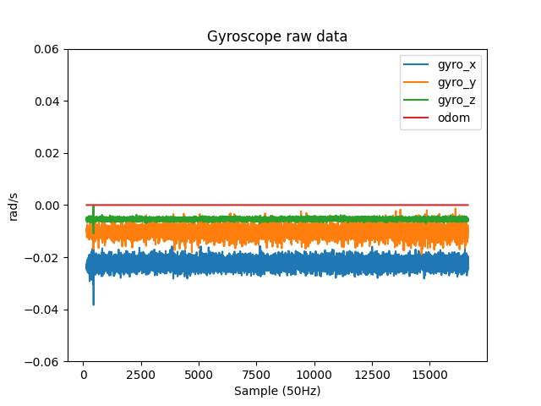
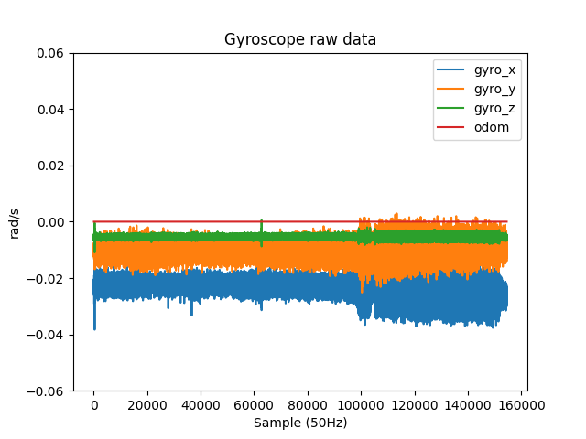
(Gyroscope) Chennai -> OK
5 mins
30 mins
Possibility: Air conditioning system
or engine speed change

Slide 10
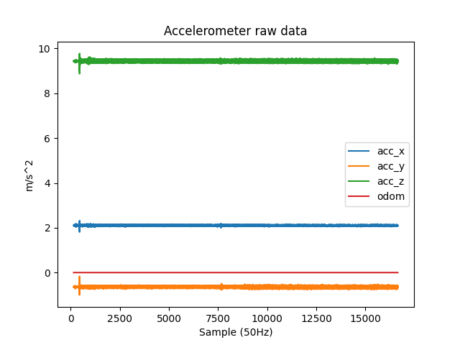
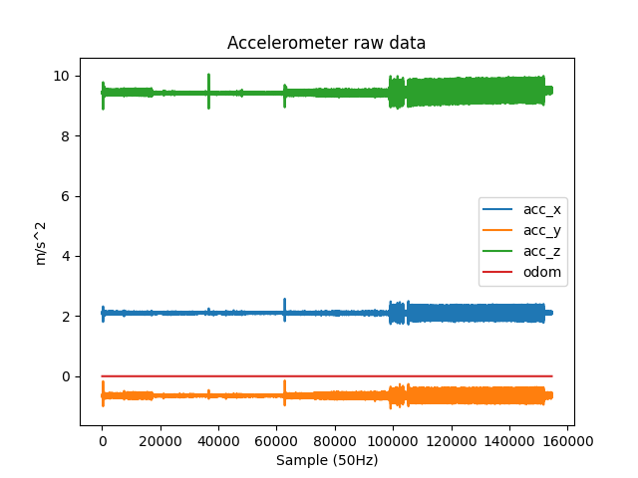
(Accelerometer) Chennai -> OK
5 mins
30 mins

Slide 11
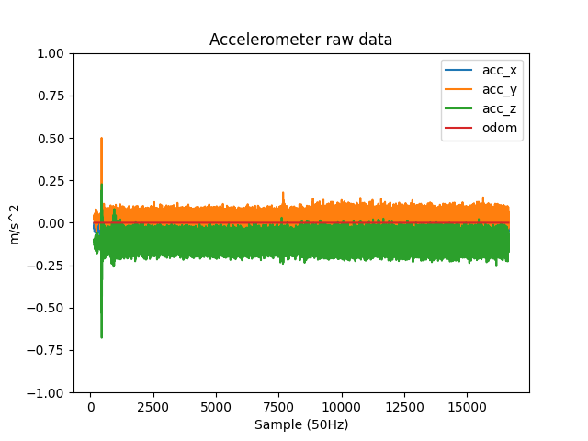
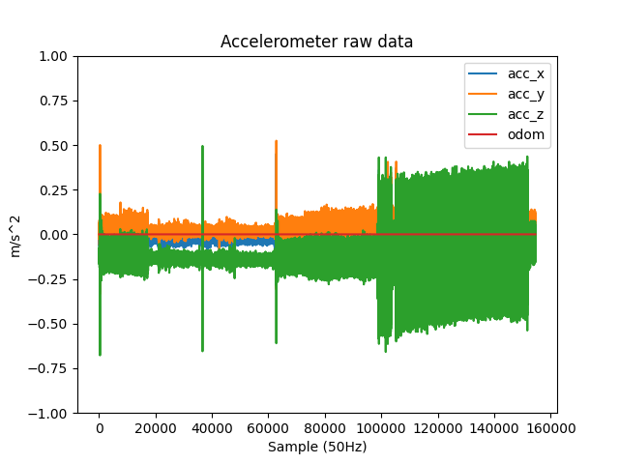
(Accelerometer, remove Gravity) Chennai -> OK
5 mins
30 mins
Possibility: Air conditioning system
or engine speed change

